Slide 1

Tourism Adoption
Capstone Project
Tourism Package Adoption
Submitted By: Preeti Singh
Batch Name:PGPDSBAOnlineFeb20_A

Slide 2
Agenda of Project
Business Problem Understanding
Modelling Approach Used and Why
Business Insights and Recommendations

Slide 3
Business Problem Understanding
This data is basically about of tourism based company. It’s objective is to launch long term travel package and offered the product to customers who are probably subscription based customers. To check the viability of market, they have gone out to certain no of customers and calculated all features of the data that is mentioned in the data .On the behalf of this, we have to predict whether a customer is taken a long term travel product or not.

Slide 4
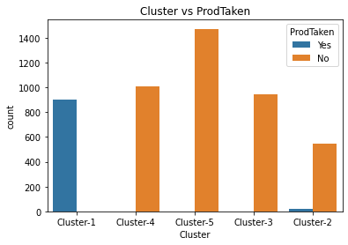
Customer Profiling
Majority of customers are three types:

Slide 5
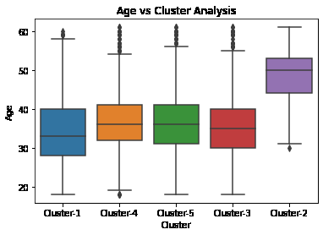
Cluster-1 is the chunk of younger age group of customers.

Slide 6
Cluster-4 and cluster 5 are the group of those customers who belong to age group 36 to 40(middle age group people).
Cluster-2 is the group of those customers who belong to age 50+(older age group people)
Cluster-3 is the group of those customers who belong to age group 35 to 40(young to middle age group)

Slide 7
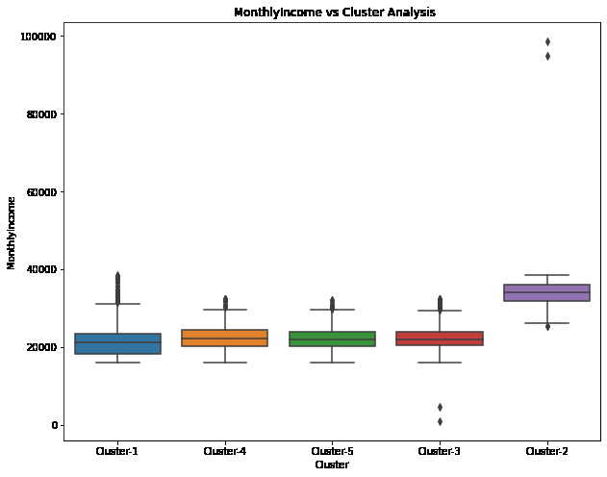
Cluster-2 is the group of those customers whose monthly income is high.
Cluster-1,Cluster-3, Cluster-4 and cluster-5 are group of those customers whose monthly income is in range of 21000-23000.

Slide 8
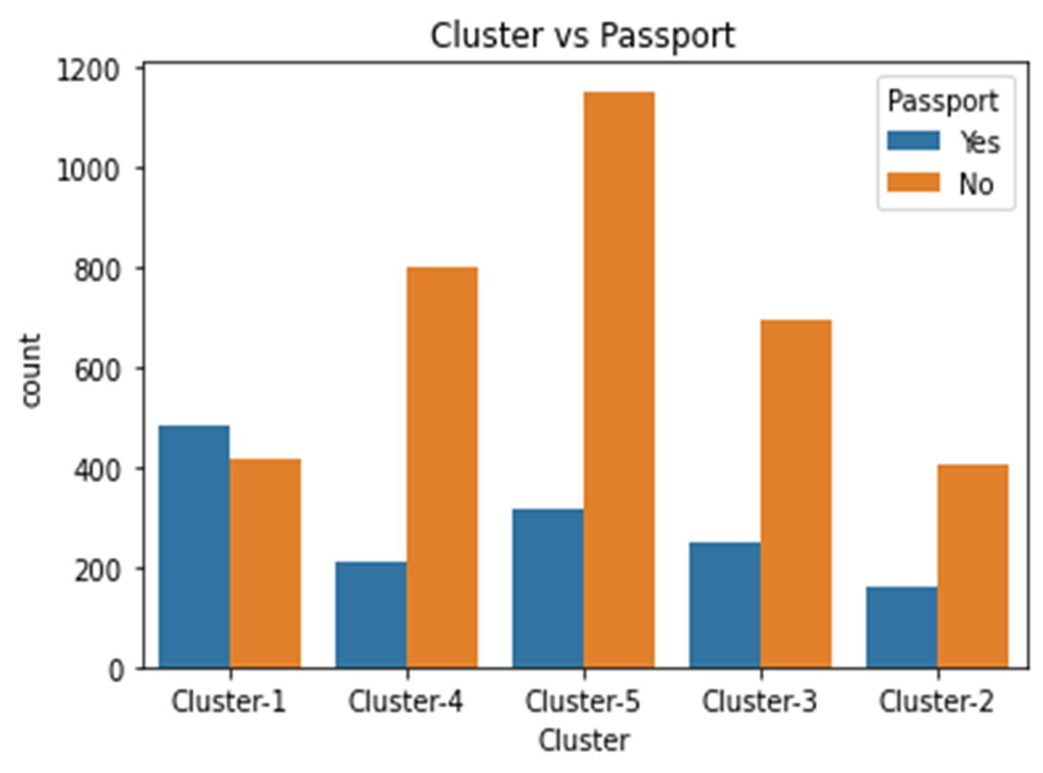
Maximum numbers of customers who have passport are in Cluster-1.

Slide 9
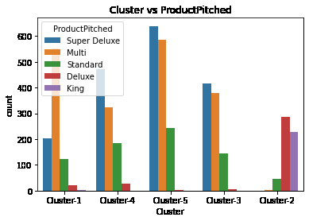
Maximum numbers of customers are buying Multi product who belong to Cluster-1.

Slide 10
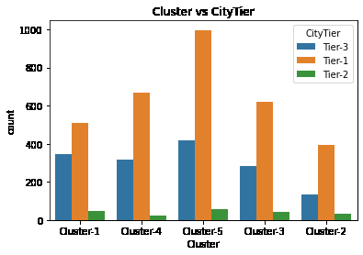
Maximum number of customers belong to Tier-1(metropolitan city ) are in Cluster-1.

Slide 11
Business Insights
Cluster1
Group of younger people, have passport, working as executive and their monthly income low
Propensity of travel will be more and buying cheaper product like multi and super deluxe
Cluster2
Chunk of older customers and very few people have passport and their monthly income high
Propensity of travel land buying a product will be low although they have high monthly income
Cluster3,
Cluster4,
Cluster5
Chunk of younger and middle age group of customers and don’t have passport, working as manager and monthly income is low
propensity of travel and buying a product are very-very low.

Slide 12
Recommendation
The data set is imbalanced. We should use SMOTE to remove imbalance data set problem.
Cluster-1 is the group of younger people who have passport also. For business perspective, Travel Company should target these people for selling the product. Also thought of some strategy so that non passport holder can get passport and their propensity of buying product could increase.

Slide 13
Modelling Approach Used
Logistic Regression
Support vector Classifier
Neural Network
Voting Classifier
Stacking Classifier

Slide 14
Logistic Regression and Why we used
Logistic Regression is used to describe the data and to explain the relationship between dependent and independent variables. It basically describe the probability of a particular data point belong to class.
Passport,NumberOfFollowups,Age,PitchScatisfactionScore,PreferredPropertyStar_code,NumberOfTrips,MonthlyIncome are the most significant features.
Notes:
.

Slide 15
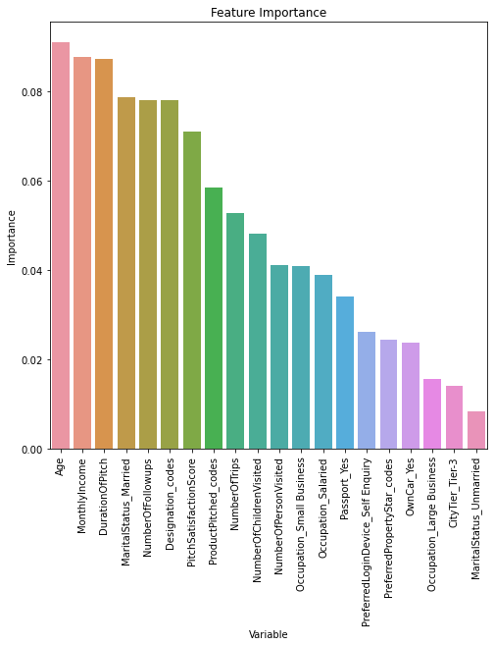
Feature Importance
In random forest:

Slide 16
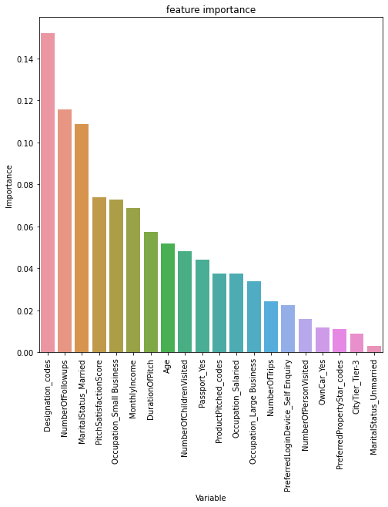
In gradient boosting:

Slide 17
Neural Network and Why used
By using this algorithms, we can recognize hidden patterns and correlations in raw data, cluster and classify it, and – over time – continuously learn and improve.
These are the hyper parameter that are used in model tuning.
'activation':['logistic', 'tanh', 'relu'],
'hidden_layer_sizes': [100,200,300,500],
'max_iter': [5000],
'solver': ['sgd','adam'],
'tol': [0.001]

Slide 18
After fitting the model we got the below are as best parameter:
'activation': 'tanh‘, 'hidden_layer_sizes': 300,
‘max_iter': 5000, 'solver': 'adam', 'tol': 0.001
AUC score(0.91) and recall (0.93) for test seta and no over fitting also.

Slide 19
Support Vector Classifier and Why used
It uses a technique called the kernel trick to transform your data and then based on these transformations it finds an optimal boundary between the possible output.
These are the hyper parameter that are used in model tuning.
'C':[0.01,1,10,20],
'kernel':['linear','poly','rbf','sigmoid'],
'probability':[True]

Slide 20
After fitting the model we got the below are as best parameter:
‘C': 20, 'kernel': 'rbf', 'probability': True
AUC(0.90) and recall(0.89) for test set.
No over-fitting

Slide 21
Voting Classifier2 and why used
To further improve the model performance there has been used Voting Classifier which is ensemble of KNN1,NN1,SVC1,Bagging with KNN model.
AUC score (0.87) and recall(0.91) is also good for test set and no over fitting.

Slide 22
Stacking Classifier(STA2) and Why used
To further improve the model performance there has been used stacking classifier wherein logistic regression is used as meta classifier and KNN1,NN1,SVC1,Bagging with KNN are used as base model.
AUC score (0.91) and recall(0.91) is also good for test set and no over fitting.

Slide 23
There are several different models that has been used in prediction.
Decision tree Classifier
Random Forest Classifier
K-Nearest Neighbour Classifier
Gradient Boosting Classifier
Naive Bayes Classifier
Bagging with Decision Tree
Bagging with KNN

Slide 24
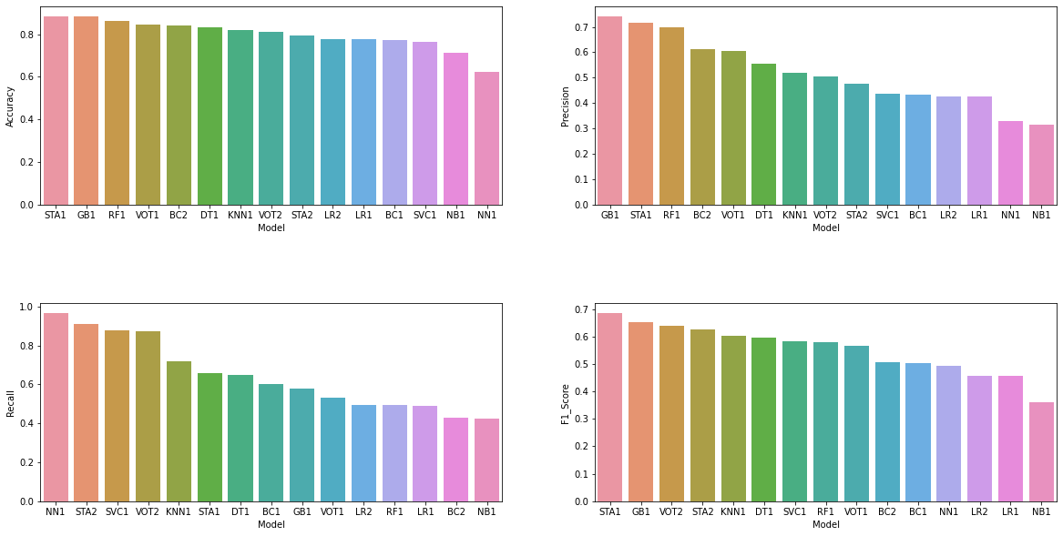
Model Comparison

Slide 25
NN1
AUC for train:1
AUC for test:0.91
SCA2
AUC for train:1
AUC for test:0.91
SVC1
AUC for train:1
AUC for test:0.91

Slide 26
Business Insights and Recommendations
How frequently a salesperson is following up with customers, increases the probability of product taken. So, for business perspective we need a very proactive and aggressive sales team.
Most of the customers who have passport, their probability of product taken is very high. Hence for business perspective, travel company should plan to provide a passport and visa services to non passport holder.

Slide 27
The another largest chunk of customers in tier3 city .Hence, the travel company should organize some campaign to increase the purchasing of product and business.
PitchSatisfactionScore also increases the buying the product. Therefore, travel company should provide some training to the salesperson so that salesperson could convince the customers easily .
Most of the customers are married and have children 2 or more and they don’t have passport. Hence for business perspective we should provide some offers and passport service to increase the purchasing of product taken.
.

Slide 28
Thank you

